Slide 1
Fundamentals Of Web Design
A N K Digital library
Students:
(Abdulrahman Bakilah)(202311481)
(Khaled Alhazmi)(202410093)
(Nawaf alzunidi)(202221108)

Slide 2
About the project
In our digital library, we showcase the most famous books in the world with the aim of spreading knowledge.
Enjoy a wide variety of books on self-development, understanding others, how the world works, and more.
This Library project is created by students loves learning web design with Ms. Sara Alsabeg.

Slide 3
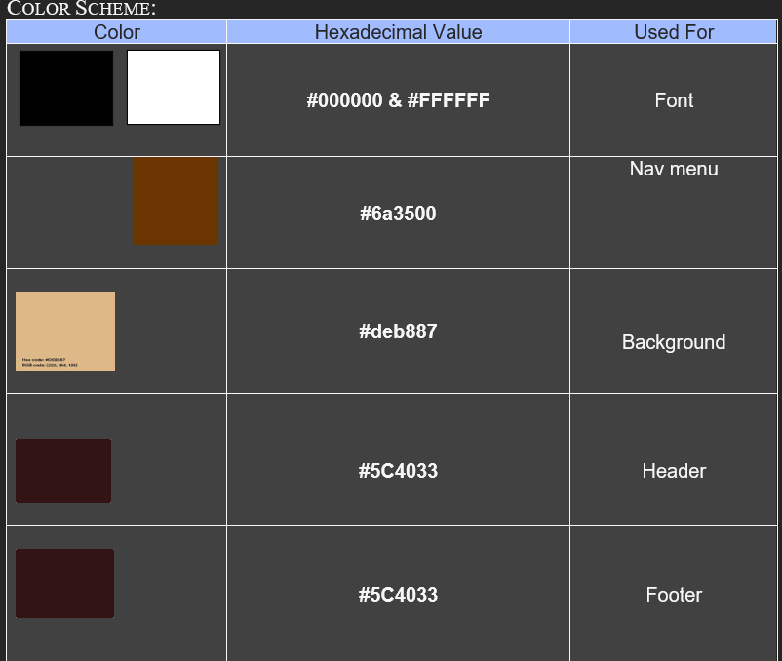
Color Scheme

Slide 4

Fonts Used
The fonts mainly used are:'Segoe UI', Tahoma, Geneva, Verdana, sans-serif;

Slide 5
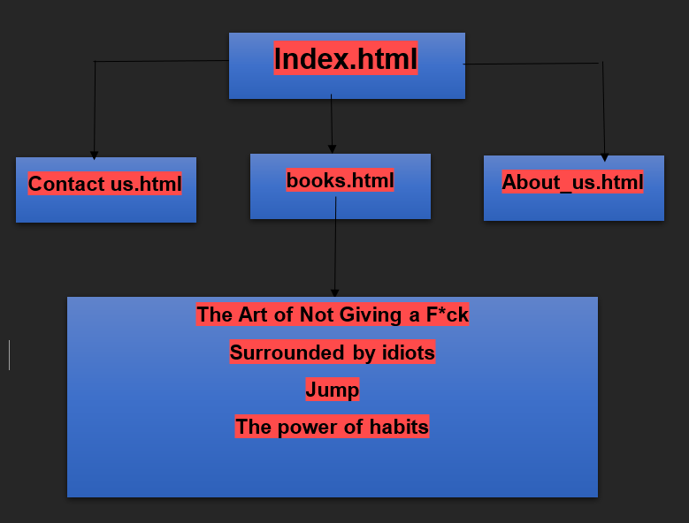
Page Hierarchy

Slide 6
Pages
1- home
2-Books
3-About us
4-contact us
All pages contain a header which has access to all the pages, a search bar and a currency option. All the pages have a footer which has the contact us information. Like, GitHub, Gmail, etc.

Slide 7
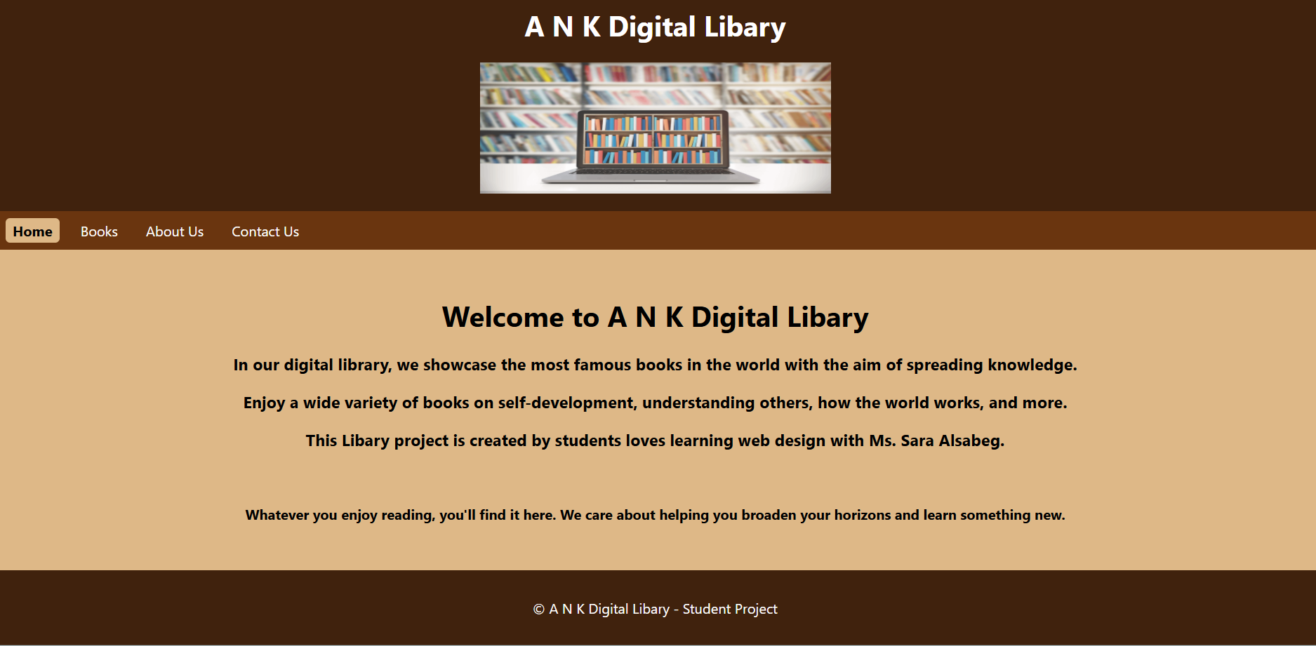
Home page
The home page has a brief introduction about the libary . There are multiple positive reviews from the visitors.

Slide 8
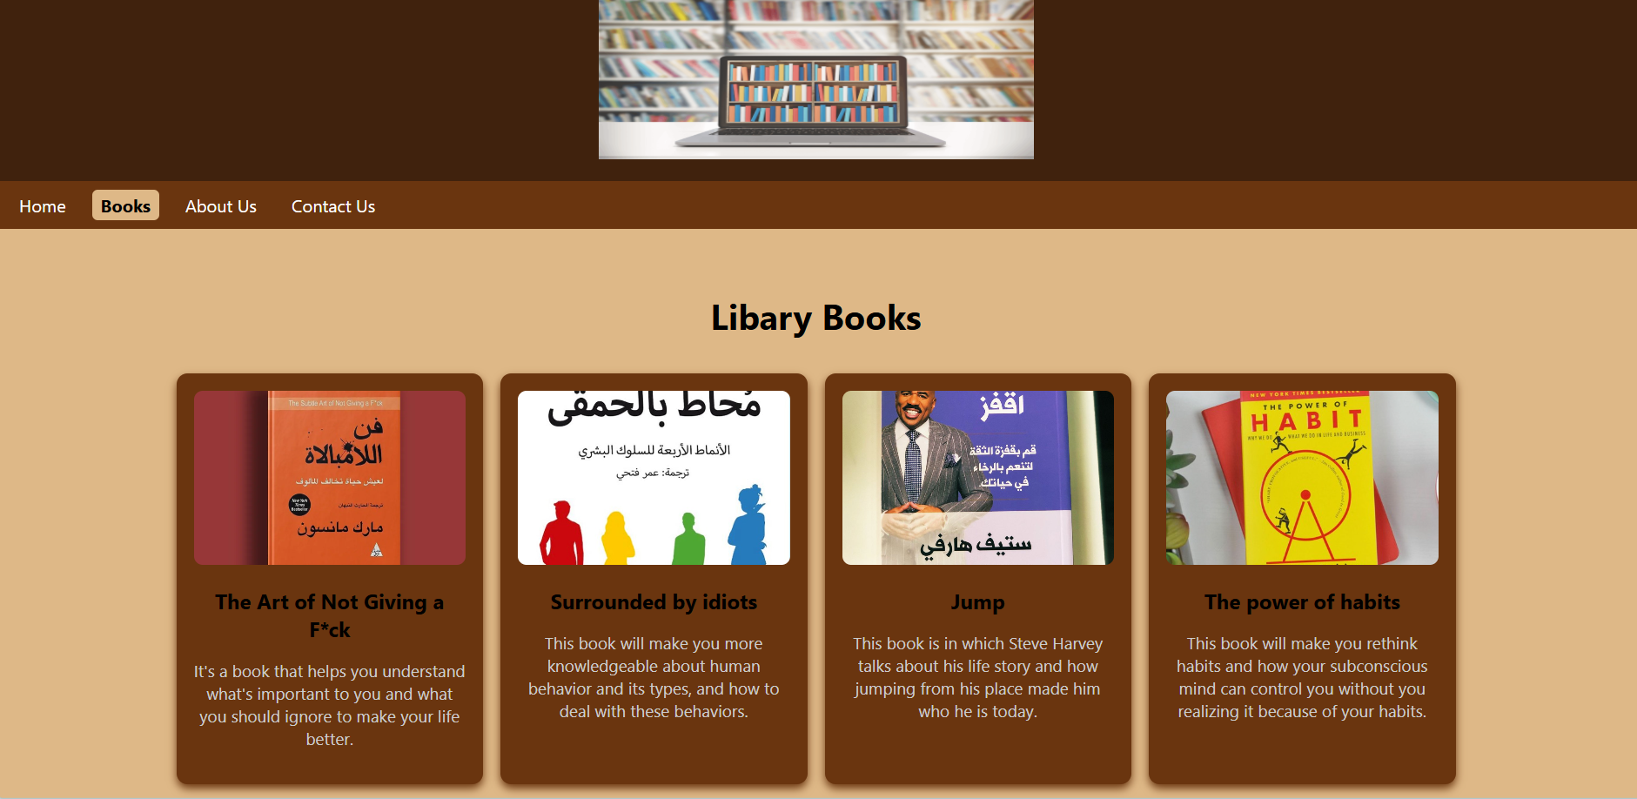
Books page:

Slide 9
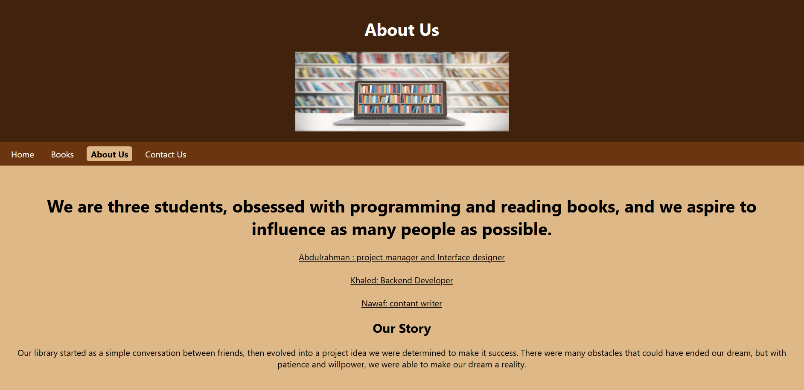
About us page

Slide 10
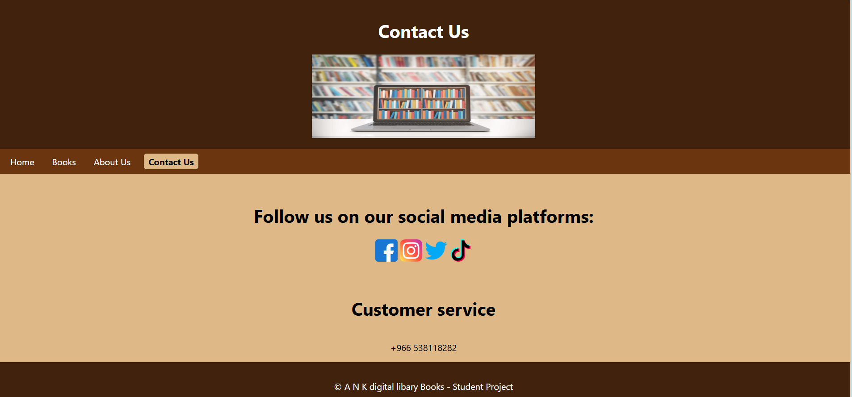
Contact us page

Slide 11
External Links
java:<link rel="stylesheet" href="my.js">
Css:<link rel="stylesheet" href="mySheet">
<link rel="stylesheet" href="sss3">
<link rel="stylesheet" href="sss">

Slide 12
Thanks

